Slide 1
This is Chemistry 3A
If you are not enrolled or waitlisted, see your counselor
All others sign in before class, sign out after
Seats are available first to enrolled students
Waitlisted students will have to stand if no available seating

Slide 2
Introductory General Chemistry
Chemistry 3A
Course Administration & Policies
S. M. Halloran

Slide 3
Course Facts & Information
Know your section: 43957 or 43958!
There are 30 students in each section
Both sections, 60 students total, will be here in room NS-101 (yes, here) from 5:00-6:20 p.m. on Tuesday and Thursday
Right after lecture, lab time in room NS-339 starting at 6:30 and going to 9:35 pm
Section 43957 goes to lab on Tuesdays Section 43958 goes to lab on Thursdays
And yes, starting this 1st week, tonight for 43957!

Slide 4
Waitlisted Procedure
Only students on waitlist have a chance of being added to course
Enrolled students who are no-shows in 1st lecture get 24 hours to make contact with instructor as to why they did not attend & if they will continue
Students attending 1st lecture (signed in) and who are on waitlist will be given Add Authorization if slots become available and in order of the queue of intent-to-enroll on waitlist. A message will be sent to add.
Students on waitlist given Add Authorization have 24 hours to add the course, or the Add Authorization is removed & given to next student on waitlist
The last day to add is the 1st day of the 3rd week (25 Aug)

Slide 5
That Guy Giving The Course
Mitch Halloran
“Mitch”
“Mister M”, “Mister H”, “Mister Mitch”
“Dr. H”, “Dr. Mitch”, “Dr. M” seems to be FCC culture here
Probably not
“Professor Halloran” (but thank you)
“Mitchell” (certainly not! Not even Mom called me that except in a fit)

Slide 6
The Project
To see you realize the objectives of the Chemistry 3A course in the Department of Chemistry at Fresno City College
In 18 weeks
Through implementation of the course design already developed

Slide 7
Communication Plan
All projects—like your success in this course—write out a communication plan
This is about what and how to communicate to move the project along
What to communicate
Asking about how to solve a problem, understanding details of an assignment, when is a deadline
Helping each other with reminders, setting up an interactive meeting online or in person
How to communicate
Email
Canvas online system

Slide 8
Recommendations for Successful Performance in Chem 3A
Syllabus
The syllabus is your friend, your map to how the course is supposed to go
Understand it well: generally, answers questions of highest importance to students
Broad overview or outline of course content
Materials for course: freely accessible online “book”, lab gear (coat + goggles), scientific-grade calculator
Grading: components of performance in course
Examinations: midterms and final
Homework: Assignments, including quizzes outside of lecture
Laboratory part of course: reports of experiments

Slide 9
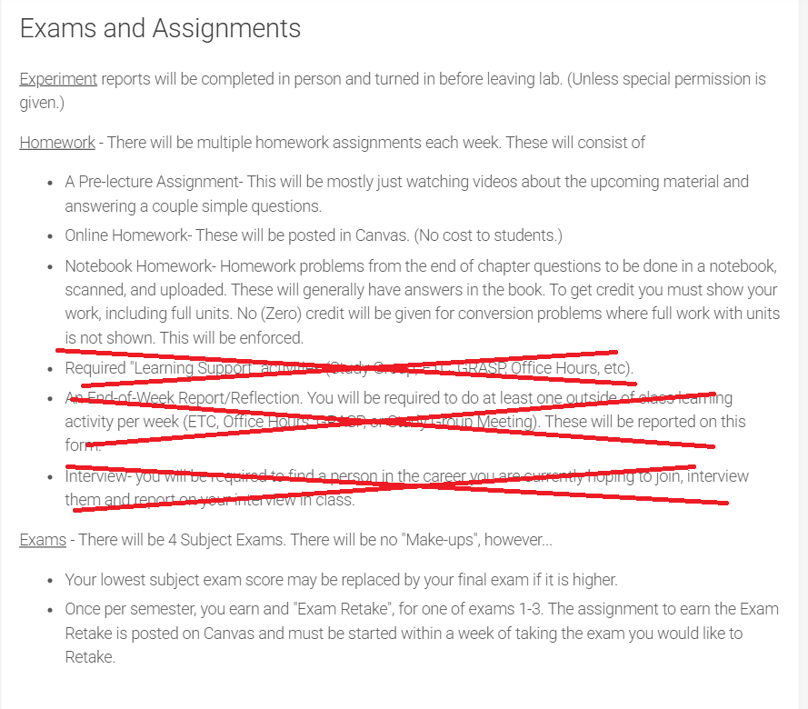
SYLLABUS CHANGES
I will be making changes to the syllabus and putting them up hopefully before Thursday’s (Aug 14) lecture
The last three list items under “Homework” will not be utilized in this course

Slide 10
Recommendations for Successful Performance in Chem 3A
Online Systems/Tools
Canvas
Announcements – look for this regularly
Course Home Page
Quizzes
In-Class Exercises
Real quizzing
Assignments
Discussions
Chat
Interaction between instructor & student(s)
Part-time instructors interact through Canvas and email
Email: Mitch.Halloran@fresnocitycollege.edu

Slide 11
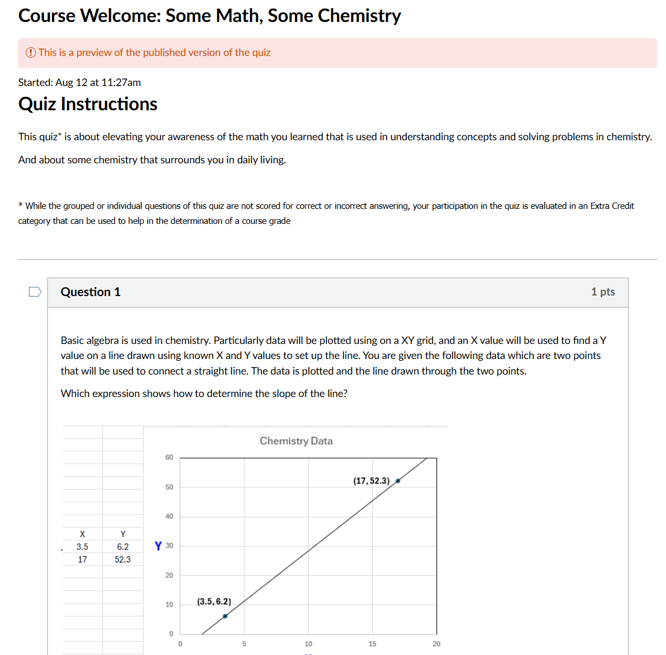
Content on Canvas app Now
There is content on the Canvas app now
Check Assignments typically
It can also link to Quizzes

Slide 12
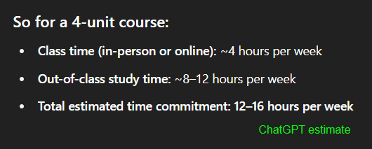
Recommendations for Successful Performance in Chem 3A
Attendance
Being at lecture & certainly being in the lab is not optional: attendance is recorded
Time Commitment
Reading, homework, study for exams/quizzes
Generally thought to be at least twice time/effort commitment of the hours (units) of lecture+lab: 4 units → 8-12 hours additional per week

Slide 13
Content For This Course
All of the content of this course, including the PowerPoints of these lectures (in PDF form), should be found in some place on the Canvas app
And if you don’t find what you are looking for, send me a message right away

Slide 14
Teamwork
Throughout your career, you will learn that projects and programs have teams of people in order to get work done successfully.
While tasks in projects are done by individuals performing roles as part of the team, the overall work is a product of the team
The “project” here at FCC in this course is learning chemistry, so everyone will be part of a team
This team is your study group

Slide 15
The Study Group
The Canvas LMS app was used to randomly group students into study groups in this course
The study group is only one facet of your learning process, intended to initiate you into being part of a team in your learning goal
Your instructor (me), your peers, resources of the College (tutors, tutoring services, counselors, other support staff) are always ready & present too

Slide 16
Artificial Intelligence in Learning & Academics
The elephant in the room? Have you been talking about it in your course of learning?
Will be transformative, but…
useful to you IF you use it properly
ChatGPT/Bing CoPilot/Gemini don’t initiate the “what if” and “why” that drives discovery and exploration
A.I. does not and will not replace humans in asking questions that push discovery
Learning the foundations of a discipline—that is, getting that Associates or Bachelors or Doctoral degree—makes you that better thinker who is asking “what if” and “why”
Doing that “homework”…
Helps you pass the test, yes
But also builds you as a discoverer, explorer, researcher, thinker

Slide 17
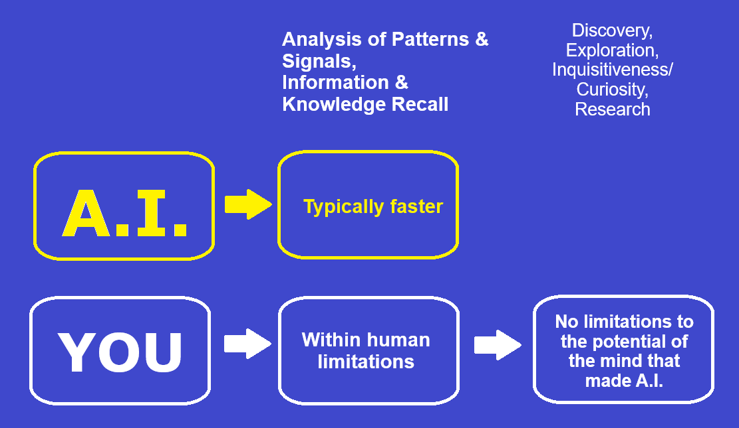
Artificial Intelligence in Learning & Academics
This is why you take Chem 3A & learn chemistry: to prepare you for doing what A.I. can’t [ever] do

Slide 18
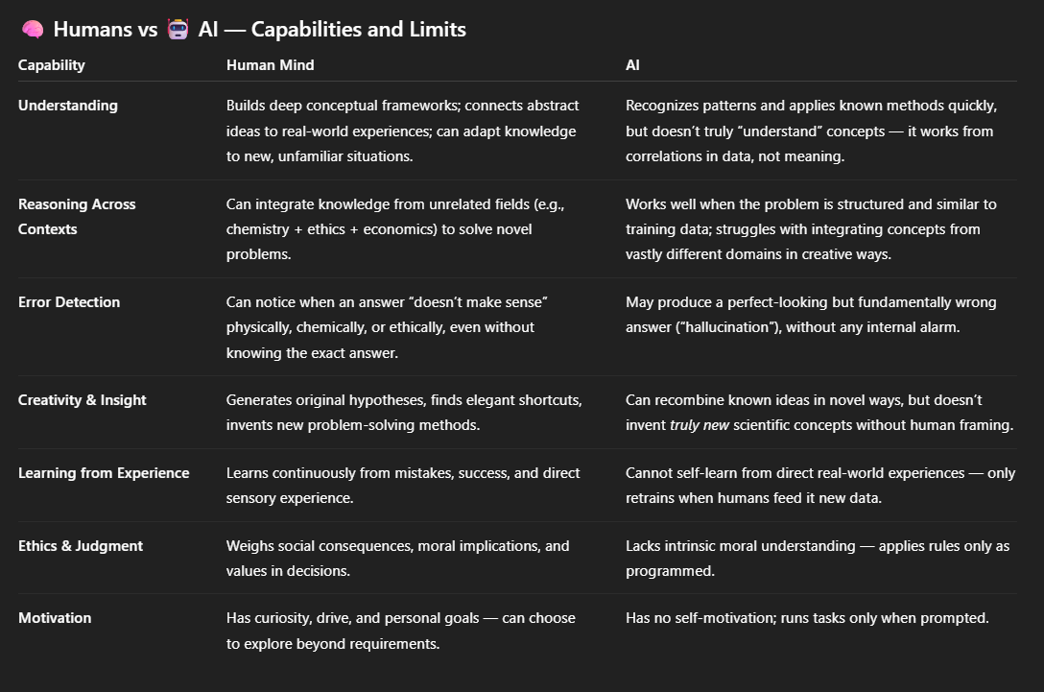
Artificial Intelligence in Learning & Academics

